Slide 1
Deep Learning
Convoluted Neural Networks Session 2
Notes:
5/20/2018
1

Slide 2
Todays Agenda
Recap of Last Presentation.
Keras Model for CNN using Dog vs Cat model.
Keras Model for CNN using MNIST dataset.
Transfer Learning (Part 1)
Adversarial Examples ( Part 1)
Questions.

Slide 3
Designing - CNN Models
There are lot of decisions to make when designing and configuring your deep learning models.
Many of these decisions, can be resolved by copying the structure of other Models.
Another approach is to design small experiments and evaluate options, using real data.
High Level Decisions: Number, Size and Types of layers in your Model.
Lower Level Decisions: Loss Functions, Activation Functions, Epoch, Batch size and Optimization Procedures.

Slide 4
Tuning a CNN -Hyper Parameters
Architecture
Number of Layers
Number of Neurons in each Layer
Regularization Parameters
Learning Rate

Slide 5
Tuning a CNN -Hyper Parameters (cont’d)
Dropout Rate
Weight Sharing
Activation Function (linear, sigmoid, tanh, relu)
Loss/Divergence Function (MSE, Cross Entropy, Binary Cross Entropy)
Algorithm for Weight updates (SGD, Adam, RMSProp…)

Slide 6
Keras Basics for CNN
Network Design
([CONV->ReLU->Pool->CONV->ReLU->Pool->FC->Softmax_loss(during train)])
Learning Parameters of a Model.
Hyper Parameters.
Model Checkpoints/Callbacks.
Model & Weights Save and Restore.
Optimizer, loss, Activation Functions

Slide 7
Sample code
Jupyter Notebooks code

Slide 8
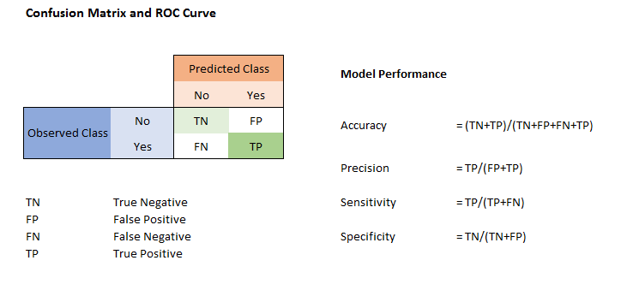
Confusion Matrix
http://www.marcovanetti.com/pages/cfmatrix/
High Recall/Sensitivity, low Precision:This means that most of the positive examples are correctly recognized (low FN) but there are a lot of false positives.
Low Recall/Sensitivity, high Precision:This shows that we miss a lot of positive examples (high FN) but those we predict as positive are indeed positive (low FP)

Slide 9
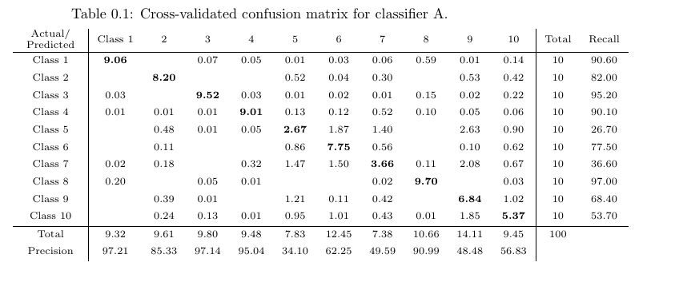
Sample Confusion Matrix.

Slide 10
Flow
Initialize libraries & Variables
Get the Data
Define Model
Compile Model
Train Model
Save Model (optional)
Save Best Weights (optional)
Evaluate Model
Predict using saved Model (optional)

Slide 11
Transfer Learning
Storing knowledge gained while solving one problem, and
applying it to a different but related problem.
Why use Transfer Learning.
Training a Model, from scratch, requires lot of input data.
Very deep networks are very resource and cash expensive.
Determining the topology, and hyperparameters is black magic.

Slide 12
Transfer Learning for Images
ImageNet :
14 Million Pictures
20,000 Categories
Ready Made Models
Xception
VGG16
VGG19
ResNet50
InceptionV3
InceptionResNetV2
MobileNet
DenseNet
NASNet

Slide 13
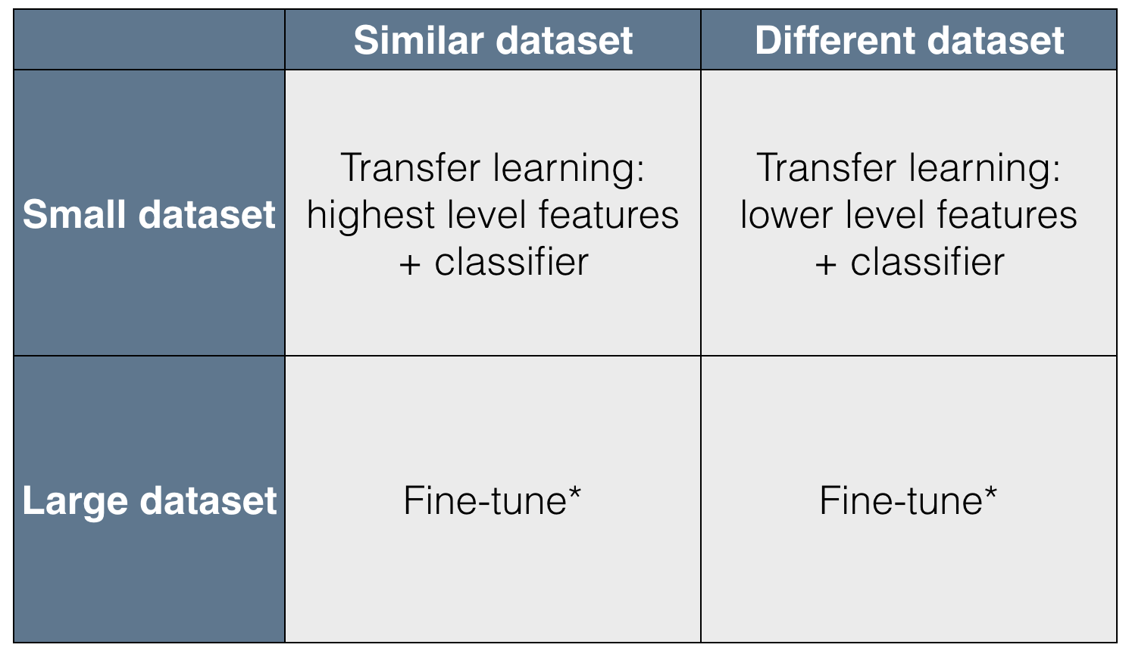
Transfer Learning Fine Tuning

Slide 14
When to FineTune a PreTrained Model
New dataset is small and similar to original dataset.
Since the data is small, it is not a good idea to fine-tune the ConvNet due to overfitting concerns.
Since the data is similar to the original data, we expect higher-level features in the ConvNet to be relevant to this dataset as well.
Hence, the best idea might be to train a linear classifier on the CNN codes.
New dataset is large and similar to the original dataset.
Since we have more data, we can have more confidence that we won’t overfit if we were to try to fine-tune through the full network.
New dataset is small but very different from the original dataset.
Since the data is small, it is likely best to only train a linear classifier.
Since the dataset is very different, it might not be best to train the classifier form the top of the network, which contains more dataset-specific features.
Instead, it might work better to train the SVM classifier from activations somewhere earlier in the network.
New dataset is large and very different from the original dataset.
Since the dataset is very large, we can afford to train a ConvNet from scratch.
However, in practice it is very often still beneficial to initialize with weights from a pretrained model.
In this case, we would have enough data and confidence to fine-tune through the entire network.

Slide 15
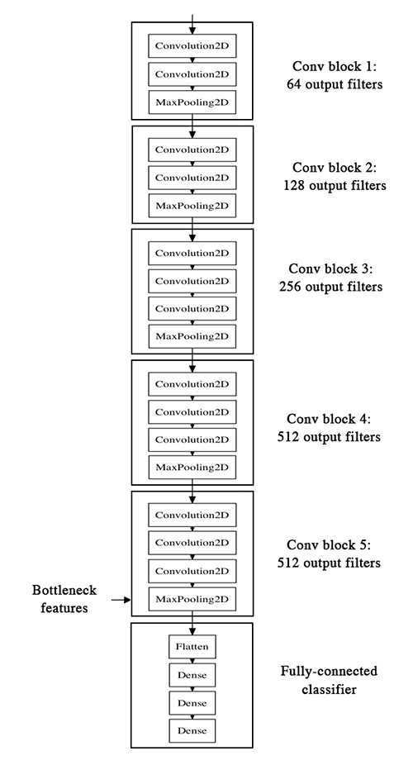
VGG16 Architecture

Slide 16
VGG16 Architecture
Application:
Given image → find object name in the image
It can detect any one of 1000 images
It takes input image of size 224 * 244 * 3 (RGB image)
Built using:
Convolutions layers (used only 3*3 size )
Max pooling layers (used only 2*2 size)
Fully connected layers at end
Total 16 layers
Model size: 528MB
Top-1 Accuracy: 70.5%
Top-5 Accuracy: 90.0%
Built by: Visual Geometry Group Visual Geometry Group Home Page
Varient: VGG-19

Slide 17
VGG16 Architecture
VGGNet wants to give an answer to “how to design the network structure”.
Among many choices, VGG adopts the simplest. Only 3x3 convolution and 2x2 pooling are used throughout the whole network.
VGG also shows that the depth of the network plays an important role. Deeper networks give better results.
One drawback of VGGNet is that this network is usually big. It contains around 160M parameters. Most of the parameters are consumed in the fc layers.

Slide 18
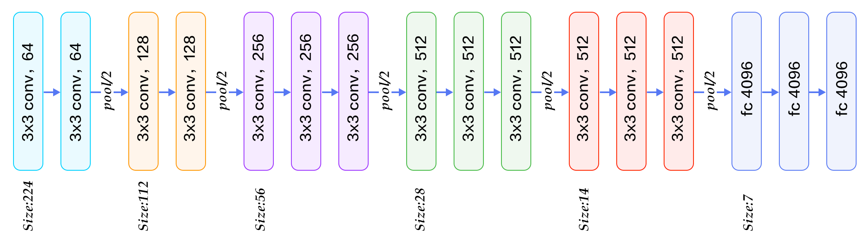
VGG16 Architecture

Slide 19
Convolution using 64 filters
Convolution using 64 filters + Max pooling
Convolution using 128 filters
Convolution using 128 filters + Max pooling
Convolution using 256 filters
Convolution using 256 filters
Convolution using 256 filters + Max pooling
Convolution using 512 filters
Convolution using 512 filters
Convolution using 512 filters + Max pooling
Convolution using 512 filters
Convolution using 512 filters
Convolution using 512 filters + Max pooling
Fully connected with 4096 nodes
Fully connected with 4096 nodes
Output layer with Softmax activation with 1000 nodes

Slide 20
Transfer Learning – Dogs vs Cats
See code

Slide 21
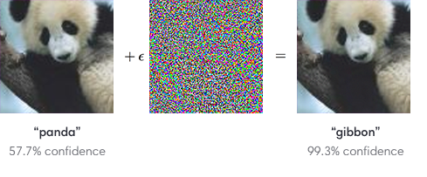
Adversarial Examples
Adversarial examples are handcrafted inputs that cause a neural network to predict a wrong class with high confidence.
The specificity of adversarial examples is that they do not occur in natural data, they are crafted. An adversarial attack against a neural network is a process in which someone slightly modifies an image so that it fools the network.
.

Slide 22
Adversarial Examples
The goal is to minimize the perturbations to the original image, while obtaining a high confidence for the target class.
Adversarial example is a set of data that was created deliberately to fool DNNs. It was found that for DNNs trained with ImageNet or AlexNet, often a small amount of change in the input can result in vast differences in the output.
For example, suppose the model recognizes a picture of a truck correctly, it may only require changing relatively few pixels in the picture for the model to classify it differently, and the changes are tiny relative to the picture that human eyes are unlikely to recognize the differences.

Slide 23
Adversarial Examples
What are their implications?
Stealing the identity of someone by wearing special glasses.
Misleading a self-driving car by altering traffic signs.
Disguise a weapon to avoid video detection.
Bypass audio or fingerprint identification.

Slide 24
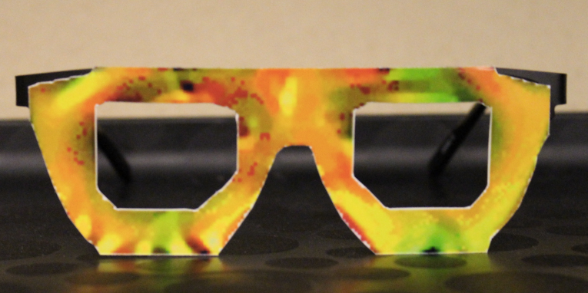
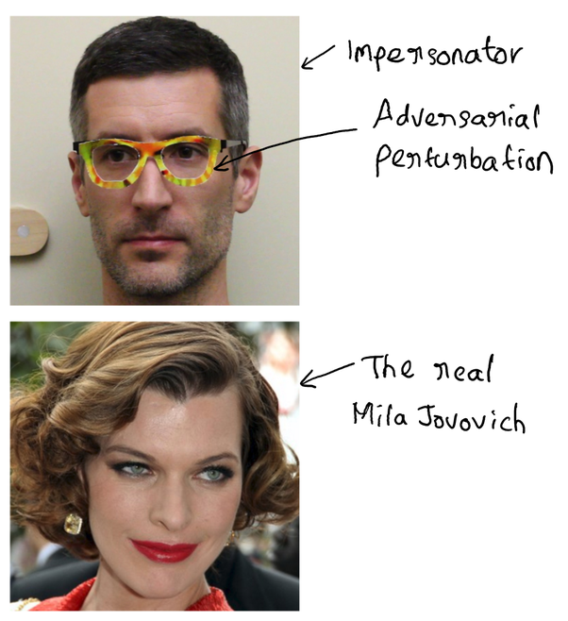
Adversarial Examples
Above Glasses, can fool commercial-grade facial recognition software into identifying the wrong person with up to 100% success rates. Researchers had the same success tricking software touted by Chinese e-commerce giant Alibaba for use in their “smile-to-pay” feature.

Slide 25
Questions

Slide 26
Contact Details
Email: aliasgertalib@gmail.com
Linkedin: https://www.linkedin.com/in/aliasgertalib

